Slide 1
THE MILE A DAY
Move • Smile • Build miles together
1
2
3
4
Can your year group become our Mile a Day champions?
Towcester C of E Primary School • Mile a Day

Slide 2
What is the Mile a Day?
A simple way for everyone to move more during the school day.
① 5 LAPS = 1 MILE
♥ EVERYONE JOINS IN
★ BUILD YOUR MILES
Walk, jog or run the school route at a pace that works for you.
It is not a race. The goal is to move, keep going and build a positive habit.
Every completed Mile counts towards your year group's total on the Mile a Day tracker.
Towcester C of E Primary School • Mile a Day

Slide 3
When will we do it?
Your teacher chooses the best time in the school day.
✓ OUR MINIMUM
★ OUR AIM
→ BE READY
At least 3 Mile a Day sessions every week.
Do it every day when we can — that can mean 5 miles in a school week!
When your teacher says it is Mile time, get moving quickly so we make the most of it.
Towcester C of E Primary School • Mile a Day

Slide 4
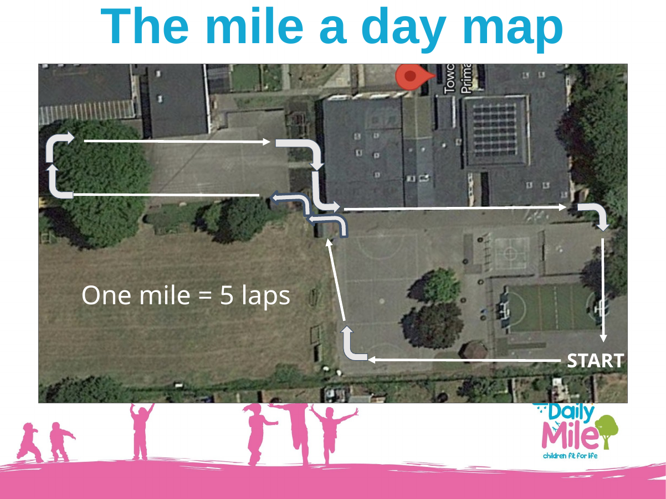
Know the route — keep it safe
Remember: 5 laps make one mile.
! THE GOLDEN RULES
• Listen to adults
• Give others space
• At the pinch point: WALK and KEEP LEFT
• Take part at the pace that is right for you
Towcester C of E Primary School • Mile a Day

Slide 5
Your miles matter!
We are building a whole-school team challenge.
LOG YOUR MILES
YEAR GROUP REWARD
Every Mile your class completes is added to the Mile a Day tracker.
Every completed Mile helps your year group build its total.
The year group that logs the most miles travelled will earn a reward!
Work together • keep moving • make every Mile count.
Towcester C of E Primary School • Mile a Day

Slide 6
Look out for our Theme Weeks!
The Mile stays simple — but some weeks will have an extra challenge.
Autumn 1
Autumn 2
Spring 1
Mindful Mile
Notice what you can see, hear and feel.
Kindness & Connection
Encourage, include and connect with others.
Feel-Good Mile
Notice how movement can change how you feel.
Spring 2
Summer 1
Summer 2
Story Mile
Build a story across your five laps.
Active Travel Mile
Spot safe, active ways to travel.
Team Towcester Mile
Work together and celebrate participation.
Towcester C of E Primary School • Mile a Day

Slide 7
What will the Theme Weeks connect to?
Movement can link with important events across the school year.
Mindful Mile
World Mental Health Day
Kindness & Connection
Anti-Bullying Week
Feel-Good Mile
Children’s Mental Health Week
Story Mile
World Book Day
Active Travel Mile
Walk to School focus
Team Towcester Mile
National School Sports Week
Towcester C of E Primary School • Mile a Day

Slide 8
EVERY LAP COUNTS
Every time you take part, you help your year group build its total.
MOVE
ENCOURAGE
KEEP GOING
Which year group will log the most miles?
Ready… set… MILE!
Towcester C of E Primary School • Mile a Day

